Slide 1

Prepared by 404-Brain-Not found
Bid Wave
Bidding for desired product

Slide 2
Introduction
This project is an online auction platform that allows users to list, bid on, and purchase products through a competitive bidding process. It features user authentication, product management, and real-time auction updates. The platform is built using modern web technologies, including React for the frontend and Node.js for the backend. It aims to provide a seamless and engaging user experience for both buyers and sellers.

Slide 3




Team Members
Rohan Reddy Patlolla
Rahul Reddy Patlolla
Swathi Jinka Rahdakrishna
Aadarsh Ravi

Slide 4
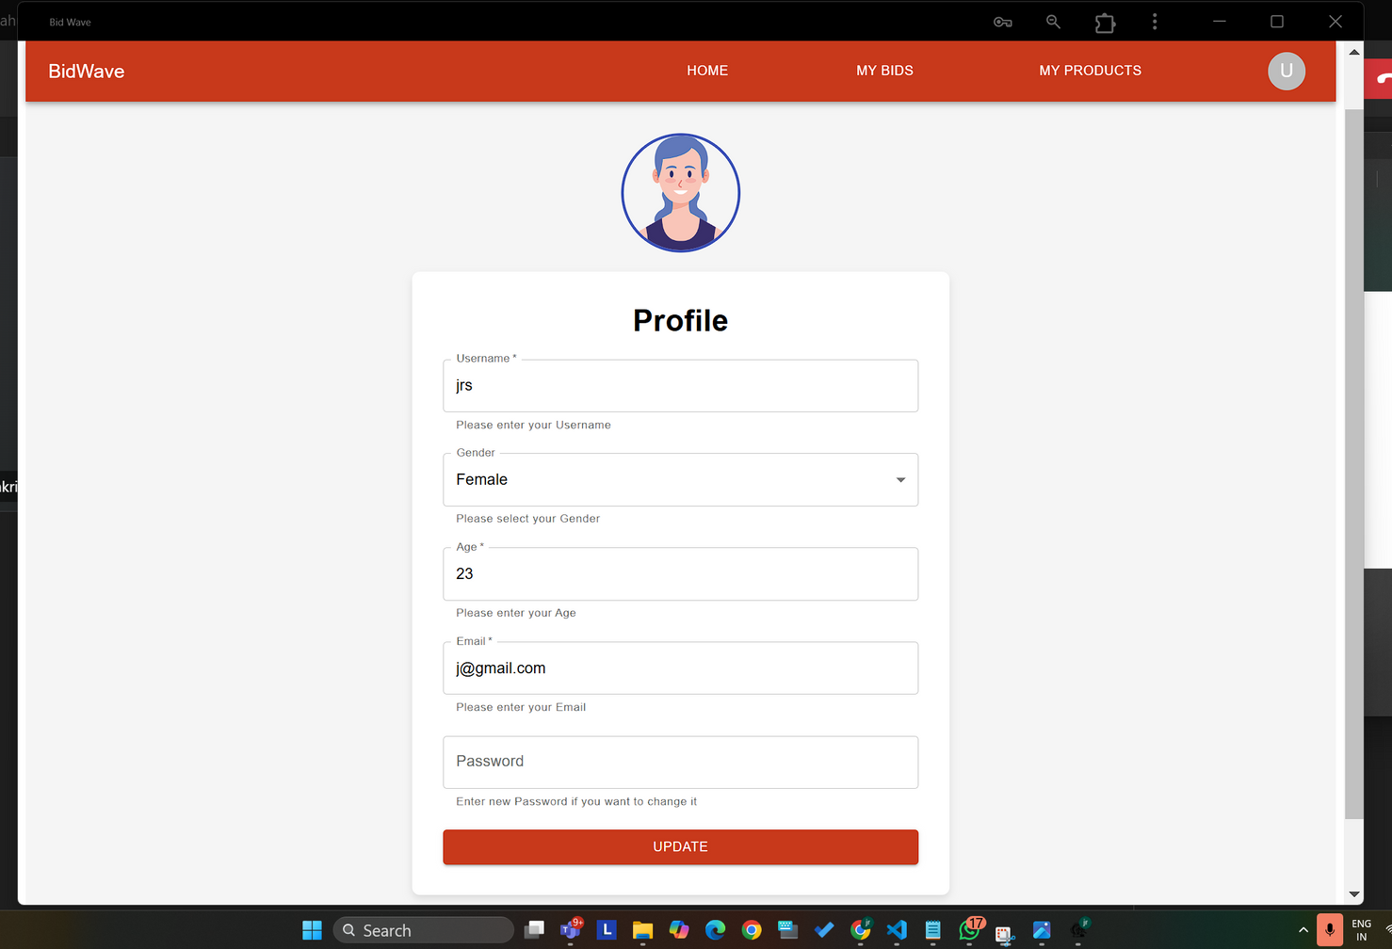
Profile Page

Slide 5
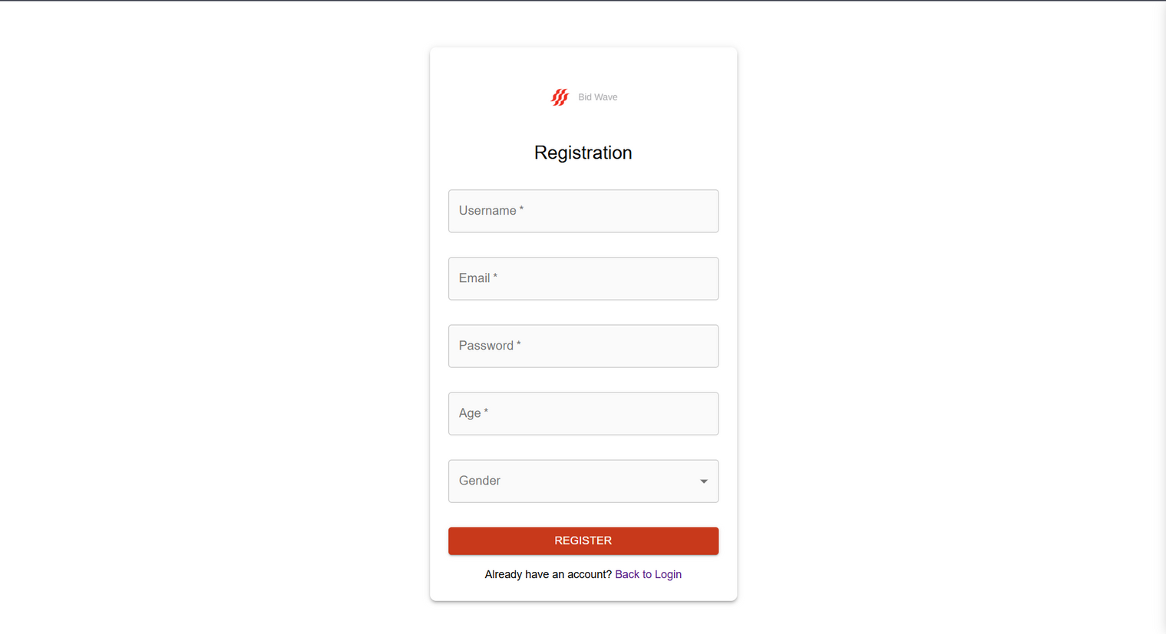
Registration Page

Slide 6
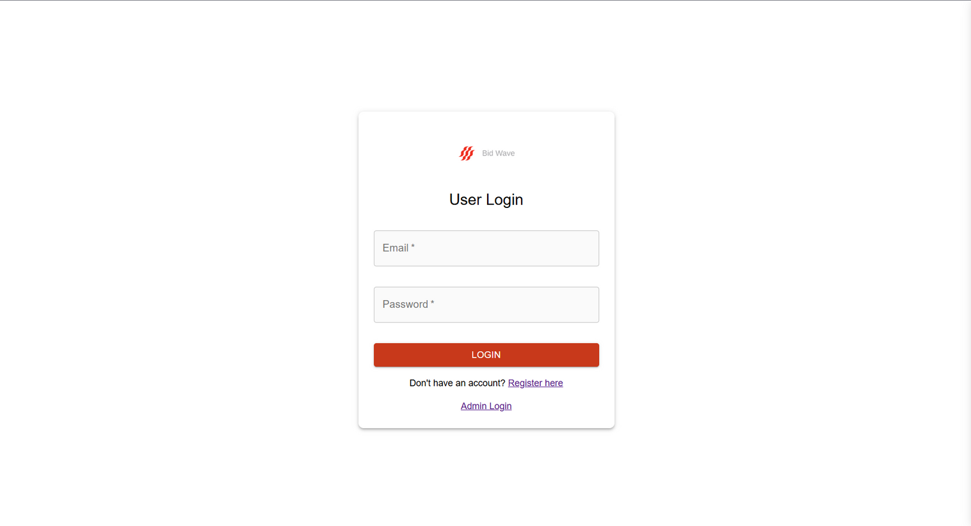
Login Page

Slide 7
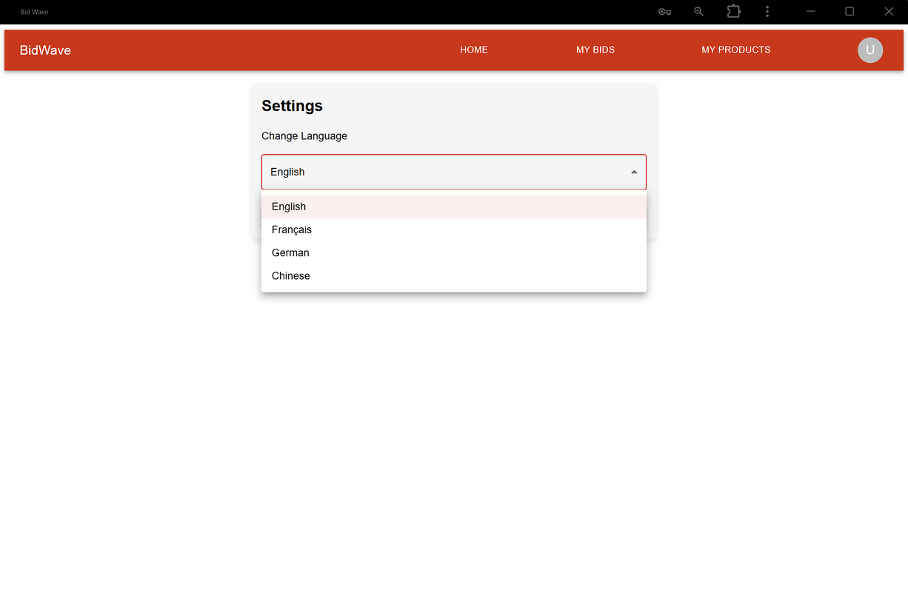
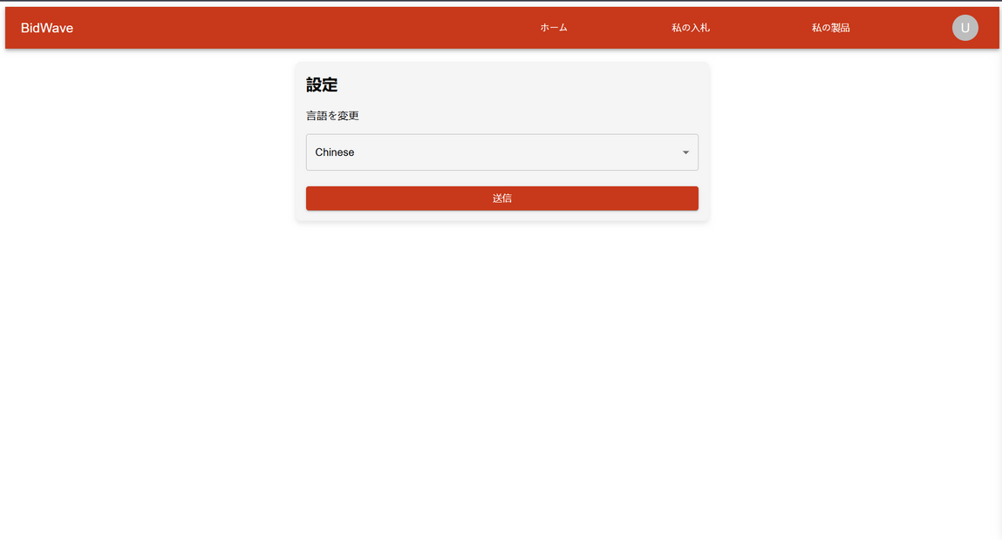
Settings Page

Slide 8
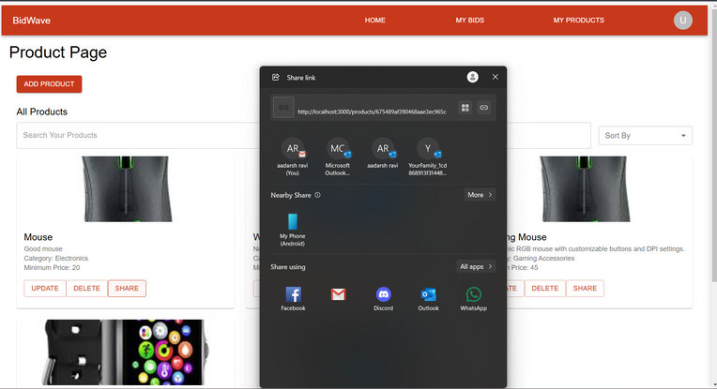
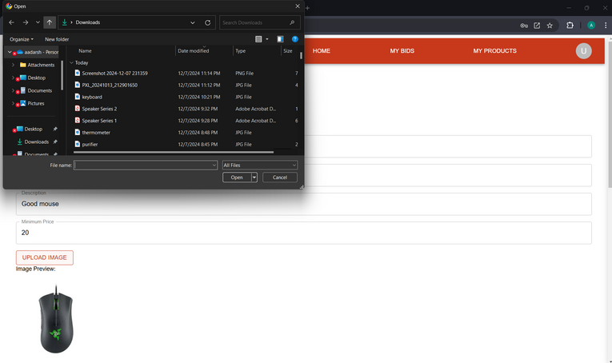
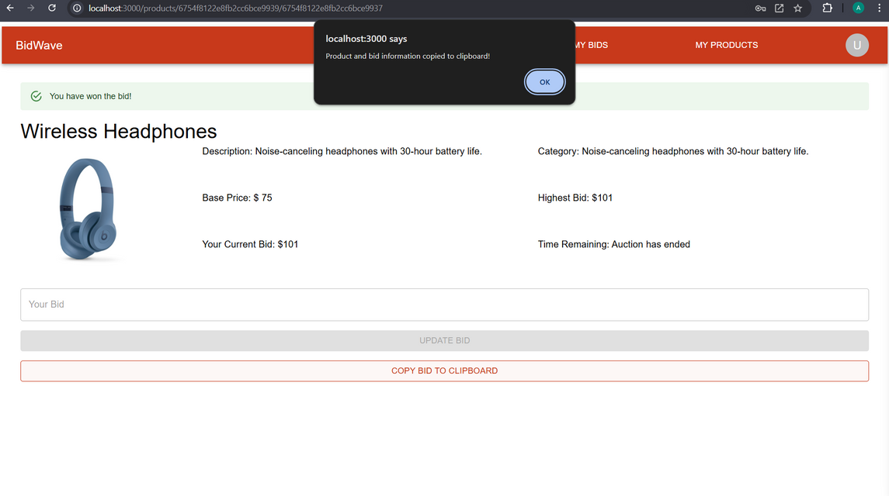
Fugu Capabilites

Slide 9
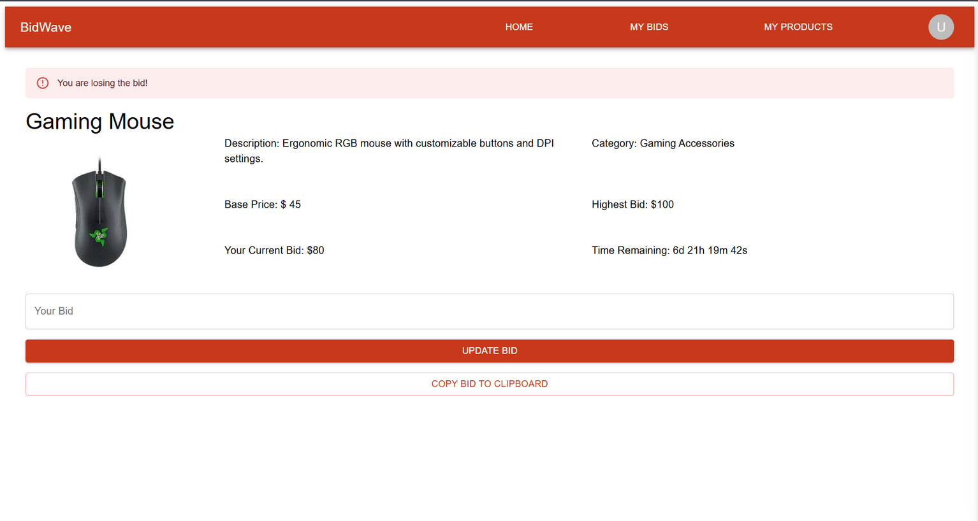
Bidding Page

Slide 10
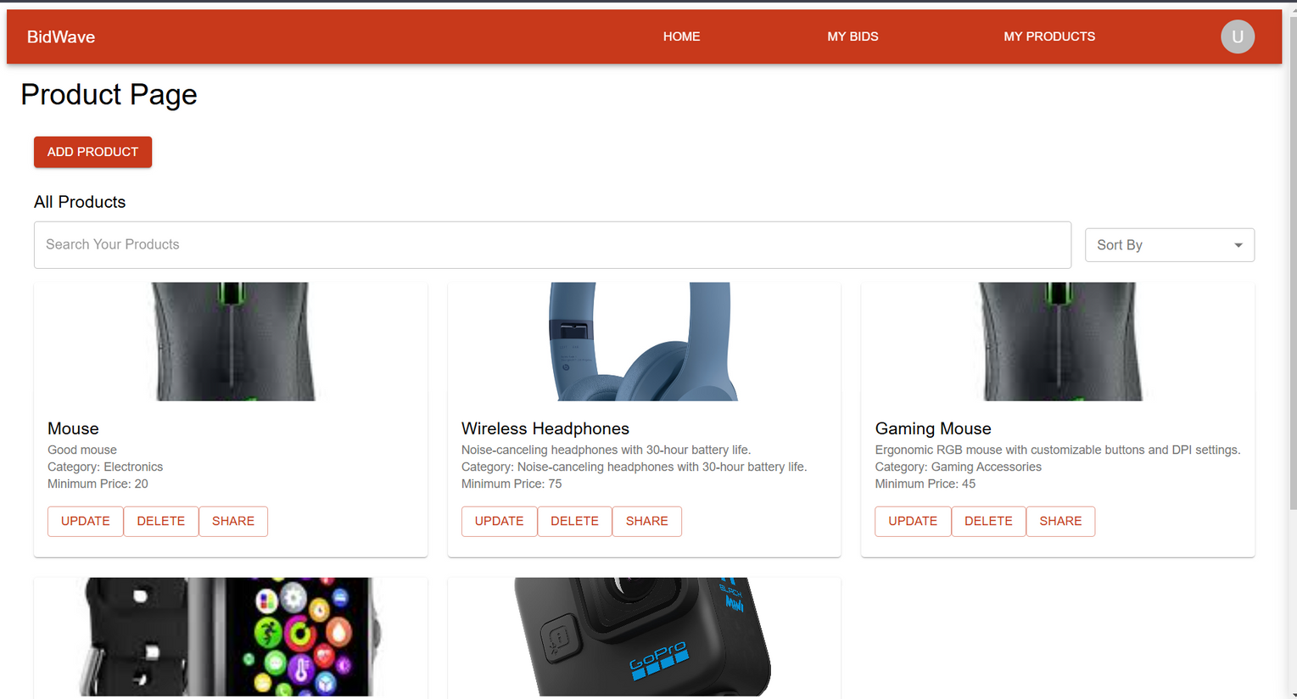
Product Page

Slide 11
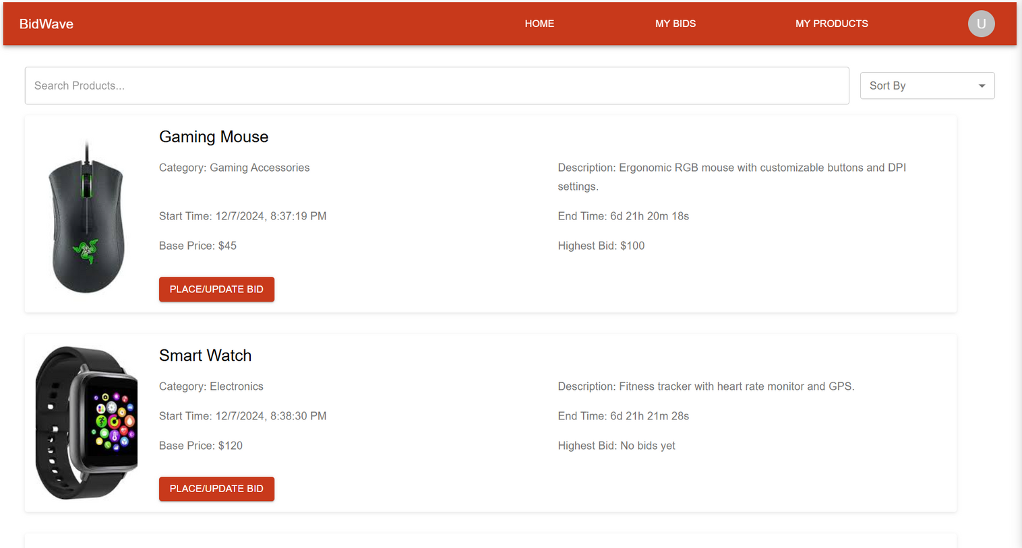
Home Page

Slide 12
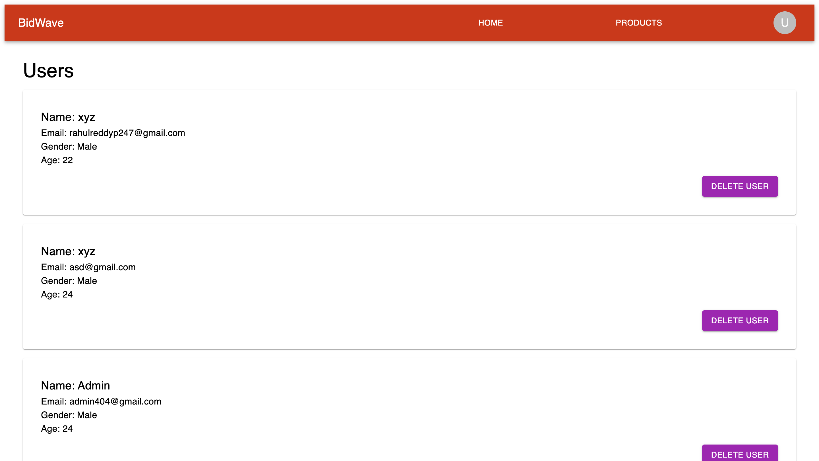
Admin Page
Here, we see all the users in the admin page.

Slide 13
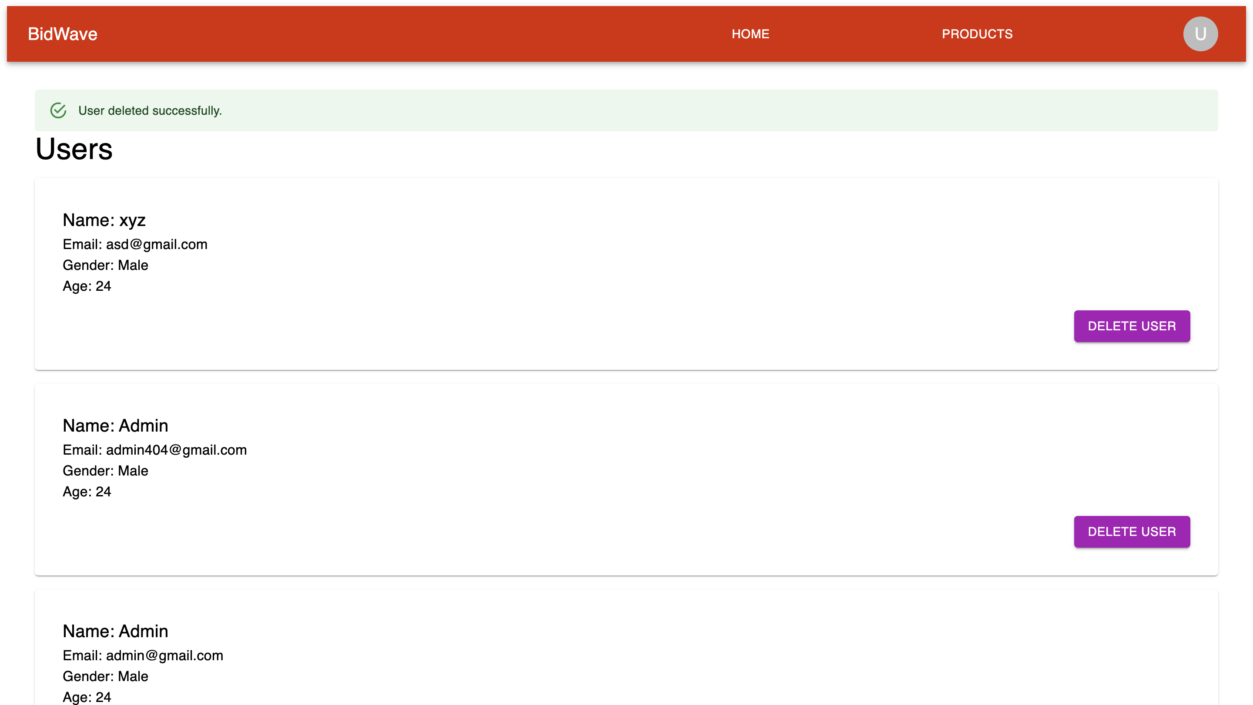
Admin Page
We can also delete the user, here we can the confirmation of deleting the user .

Slide 14
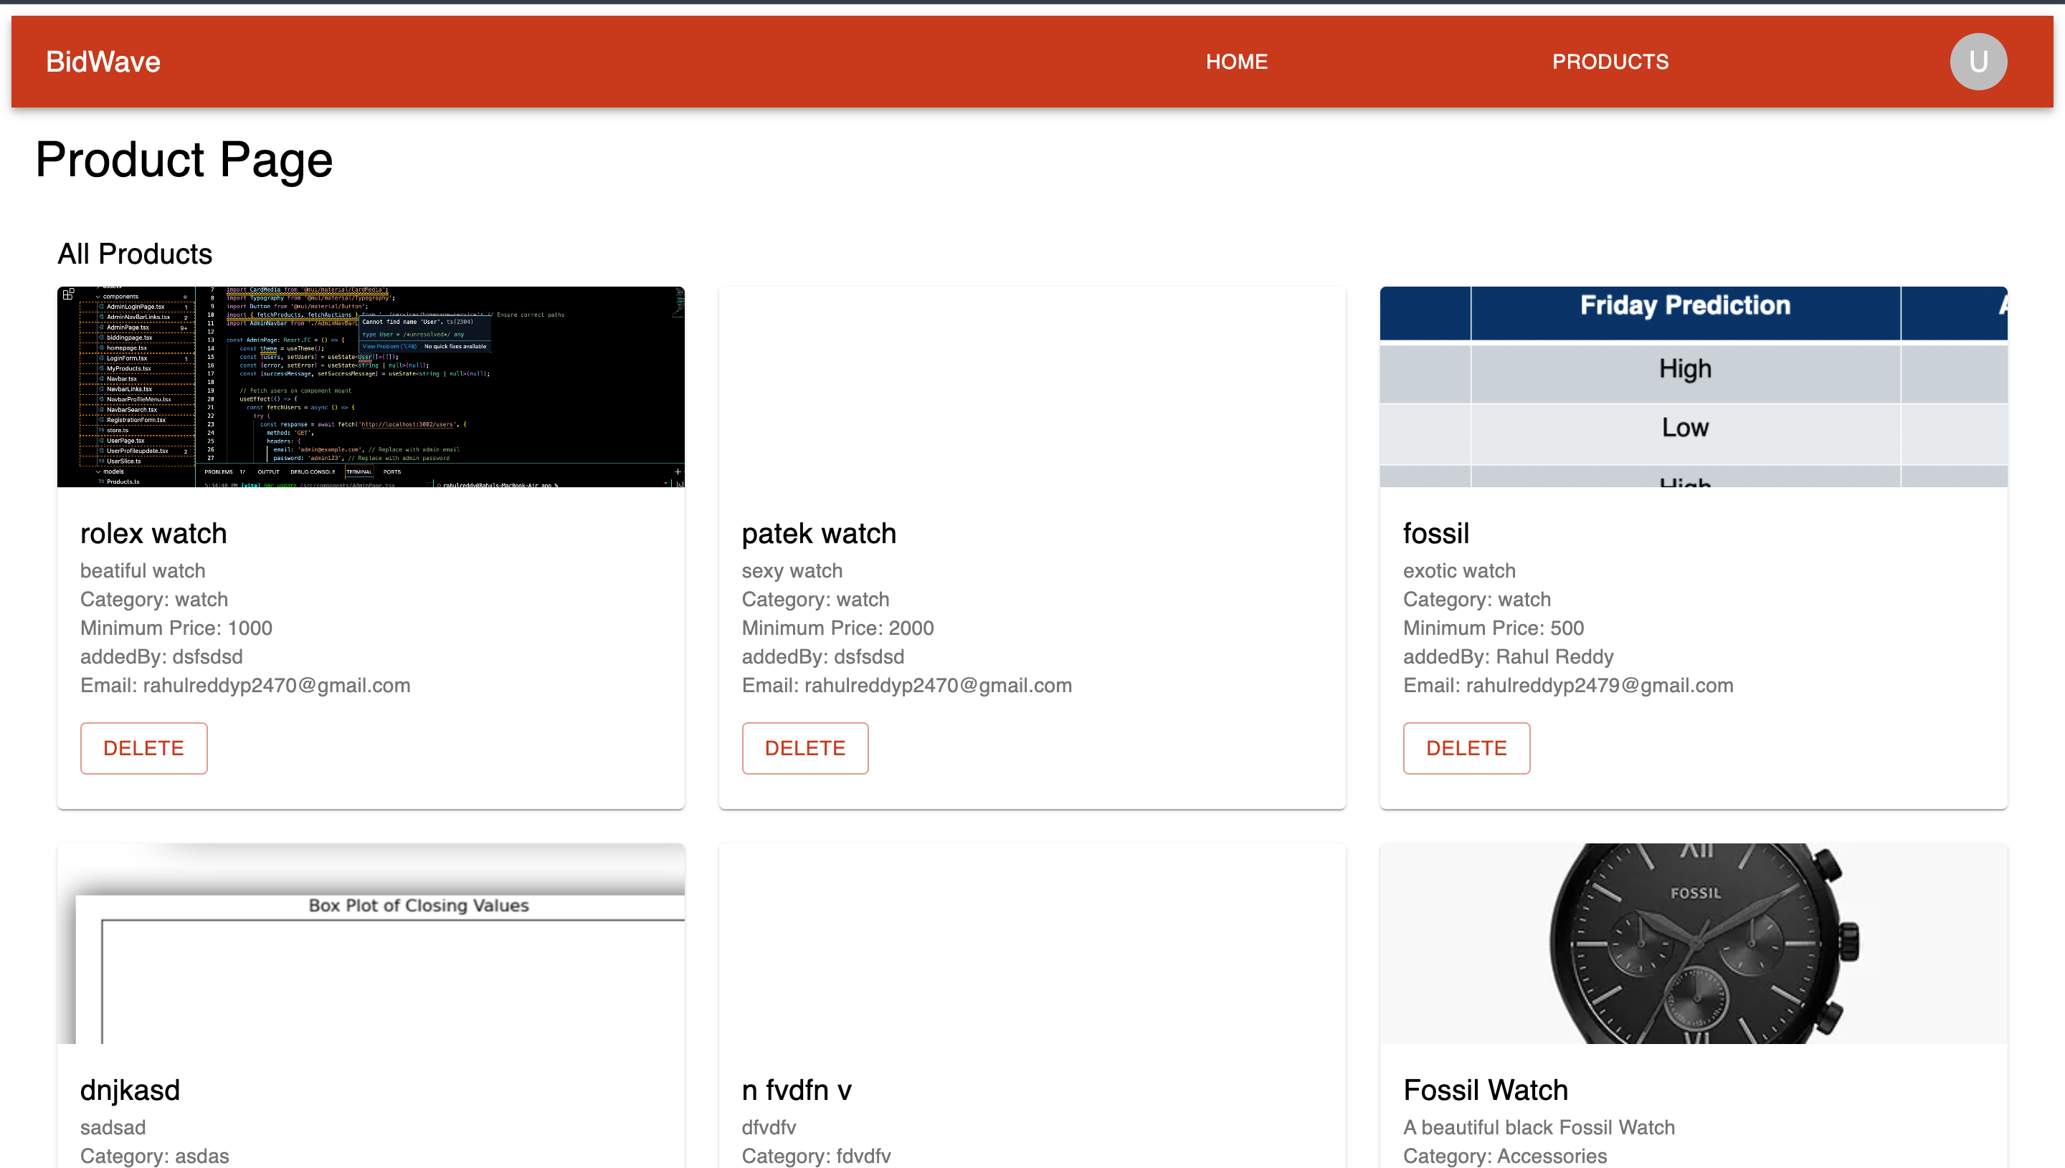
Admin Page
Here, we can see all products that are there for bidding.

Slide 15
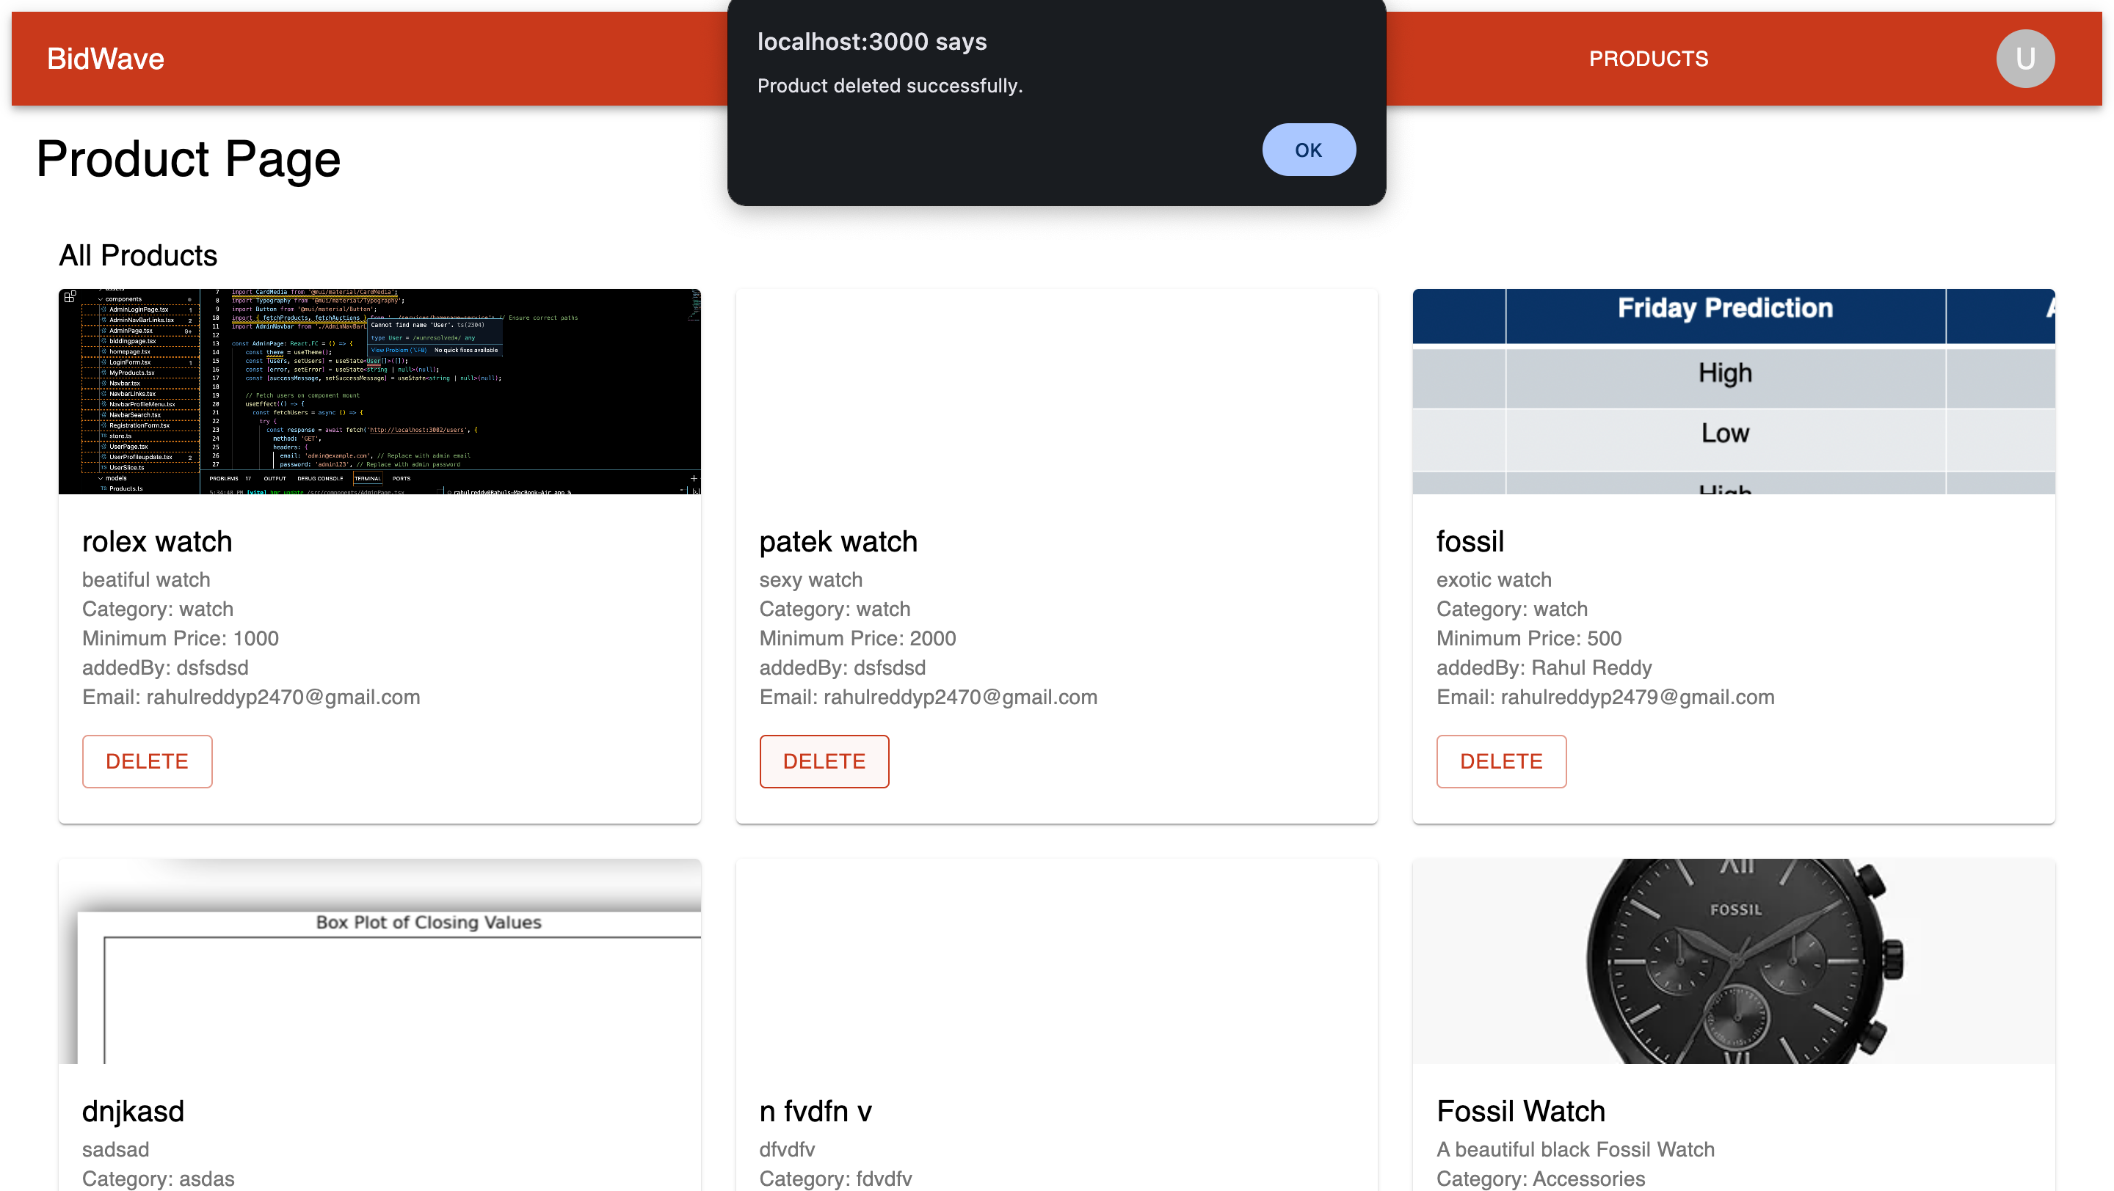
Admin Page
We can also delete the products for bidding

Slide 16
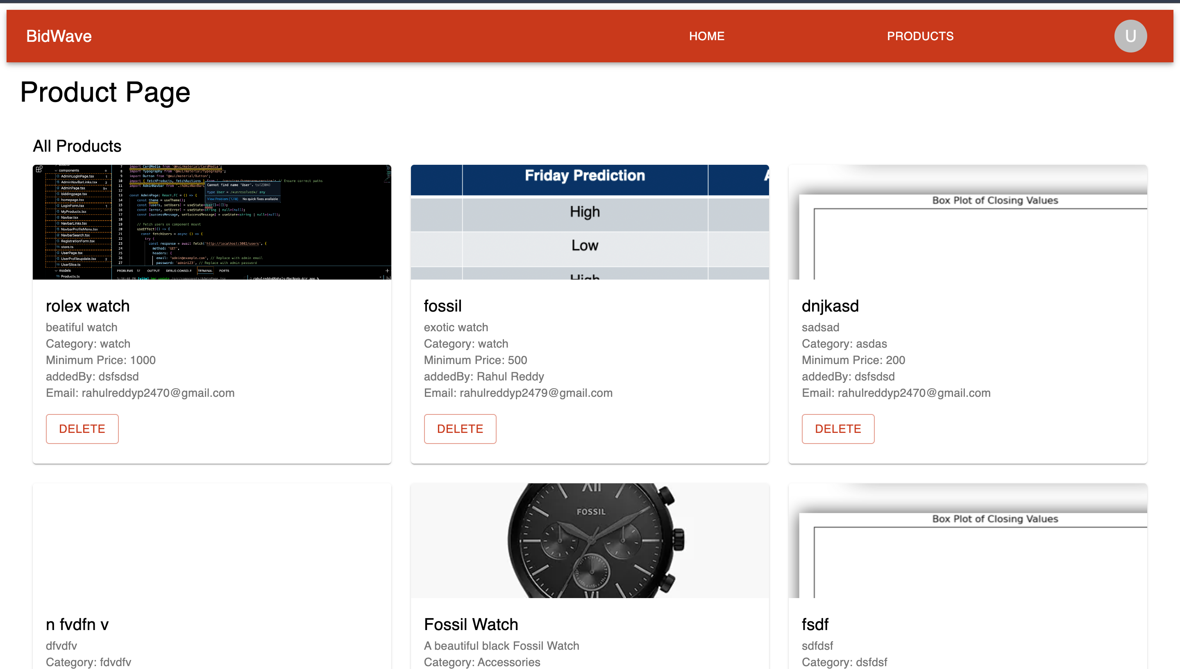
Admin Page
Here, we can see the product is deleted.

Slide 17
Thank you

